Slide 1

Title: Campus Event-Navigator Registration Hub
Student Name: Inturi Joshitha
Student ID: 2520040062)
Cluster:4
Section: 13
Under the Guidance
of
Supervisor Name: B . Srinivas
Assistant Professor : Jayaram Boga
Department of ECE

Slide 2
Abstract
The Campus Event Navigator-Registration Hub is designed to provide students with clear and organized information about college events. It displays important event details such as event name, date, venue, and scheduled activities in a structured manner. The project helps students easily explore upcoming technical and cultural events and understand the purpose of each event through a simple and user-friendly interface .
The project also includes a registration feature that allows students to submit their basic details for event participation. By using fundamental HTML elements such as headings, tables, lists, images, and forms, the project demonstrates how web pages can be created to present information and collect user input. This project serves as an effective introduction to basic web development concepts for first-year engineering students.

Slide 3
Existing System
Event information is shared through notice boards and posters.
Students depend on announcements or messages to know about events.
Event details are not available in one place.
Registration is often done manually or through different links.
Students may miss event updates or deadlines.
The process is time-consuming and not well organized.

Slide 4
Proposed System
A single web page to display all campus events.
Students can view event details like name, date, and venue easily.
Events are shown in a clear and organized format.
Students can register online using a form.
The system is simple, fast, and easy to use.
Helps students quickly know and participate in events.

Slide 5
System Architecture
Frontend: HTML, CSS, JavaScript
Backend: Basic client-side logic for form validation and interaction
Database: Not used (form collects user input only)
Modules: Event Display, Event Details, Student Registration
Users: Students, Event Participants
Data Flow: Students view events and submit registration details through the web page.

Slide 6
Project Modules
Home Module: Displays the website title and introduction to campus events.
Event Information Module: Shows details of upcoming events such as event name, date, venue, and activities.
Event Display Module: Organizes events using lists or tables for easy viewing.
Registration Module: Allows students to enter their details and register for an event.
Confirmation Module: Shows a message after successful registration.

Slide 7
Objectives
To provide clear information about campus events.
To display event details such as name, date, and venue in an organized way.
To allow students to register for events through an online form.
To create a simple and user-friendly web interface.
To demonstrate basic web development using HTML, CSS, and JavaScript.
To help beginners understand web page design and form handling.

Slide 8
Co’s Attainments - FWD
CO1: Internet Fundamentals, HTML & Introductory CSS Styling
CO2: HTML Forms, Semantic Tags & CSS Layouts
CO3: JavaScript Programming Essentials
CO4: JavaScript Interactivity, DOM & Events
CO5: Advanced Web Development & Deployment

Slide 9
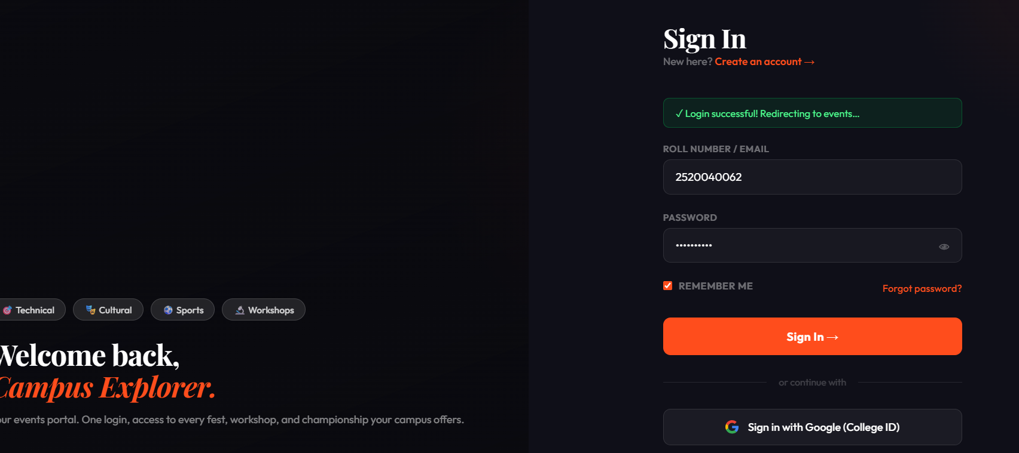
Screenshots for FWD

Slide 10
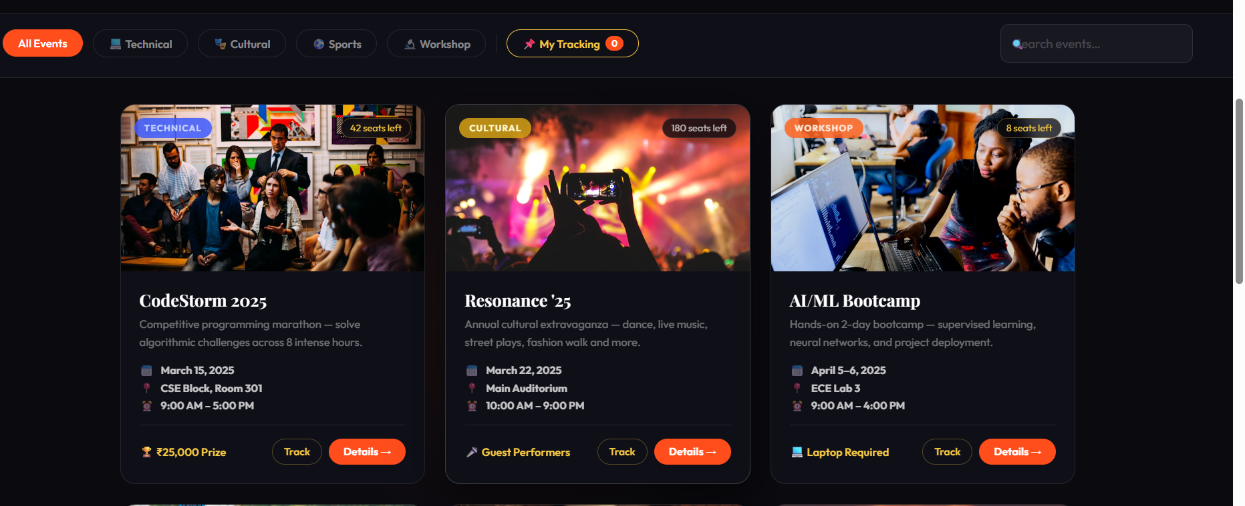

Slide 11
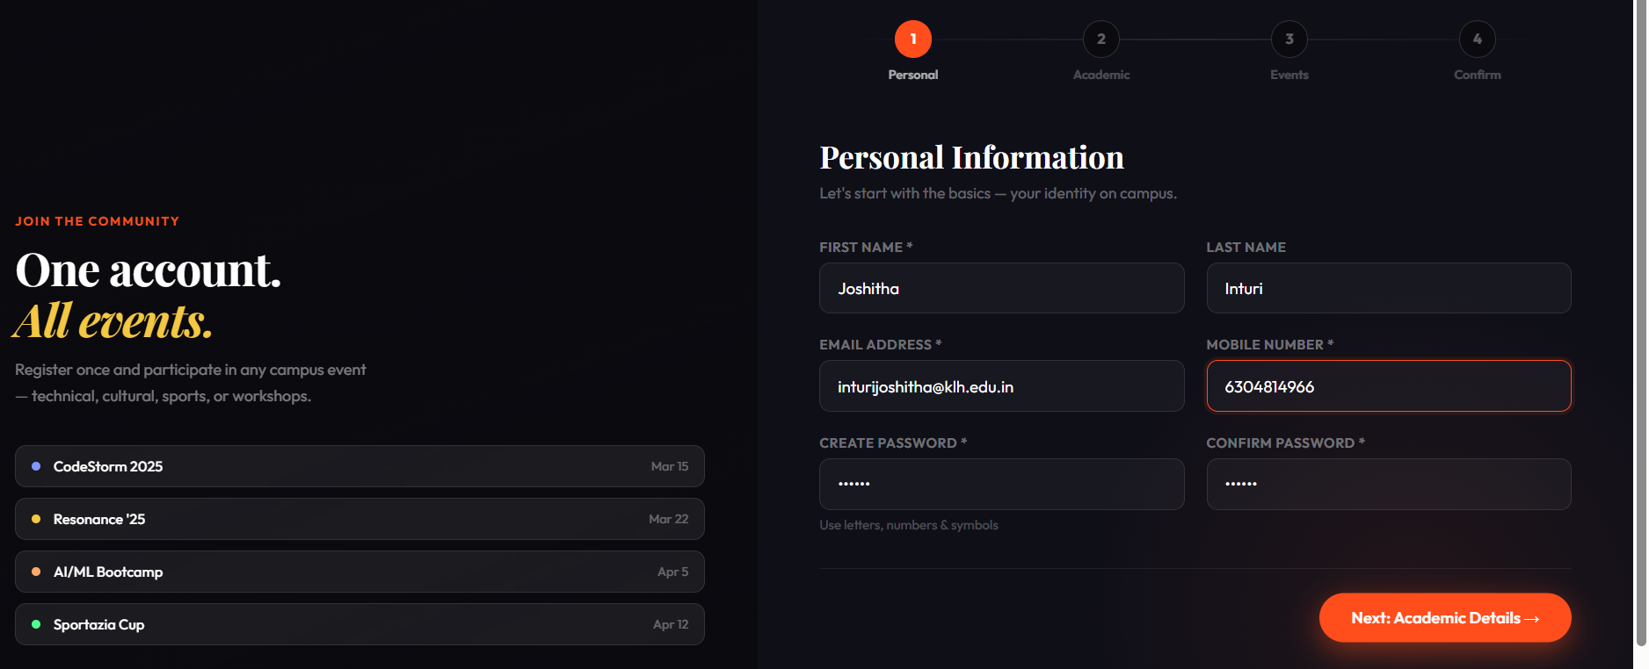

Slide 12
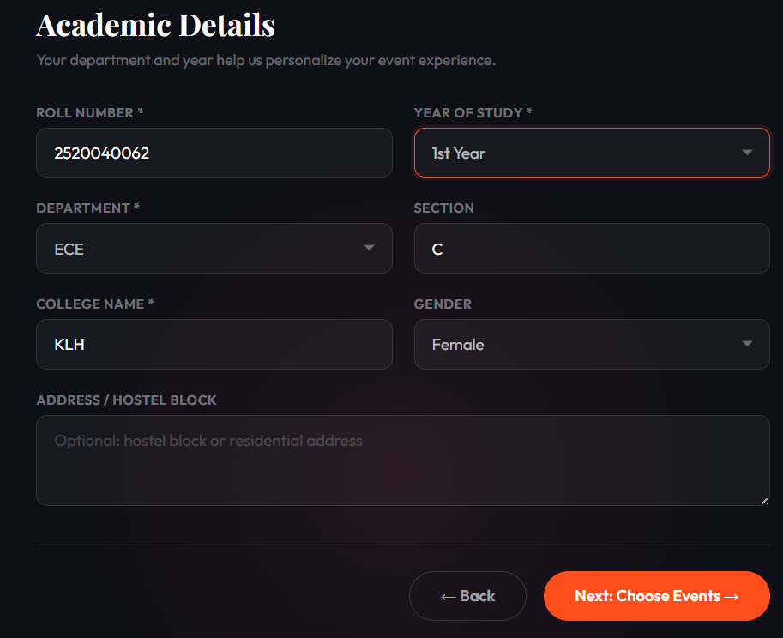
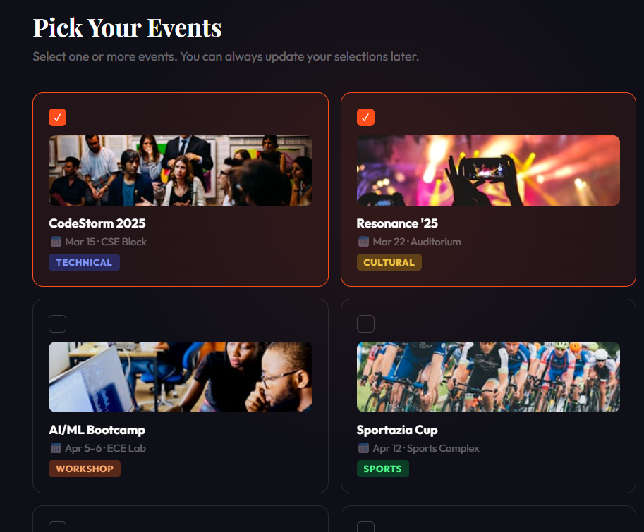

Slide 13
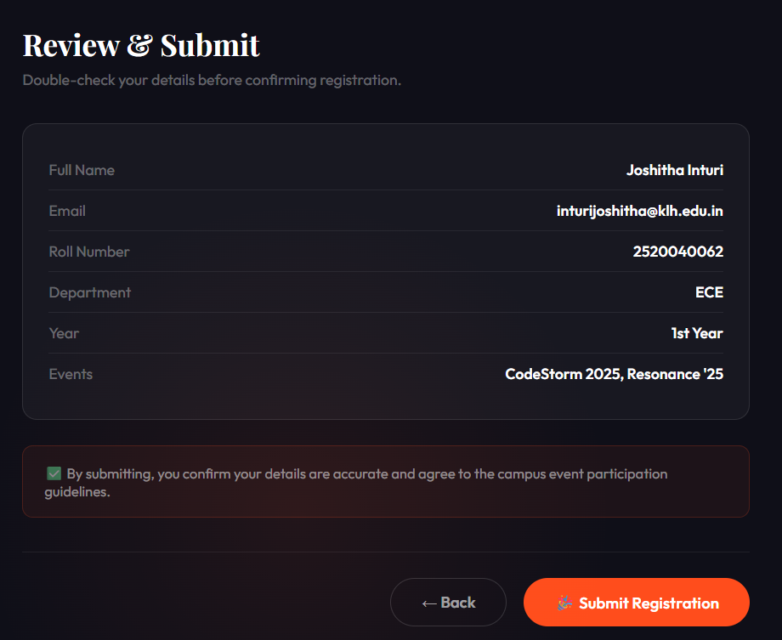
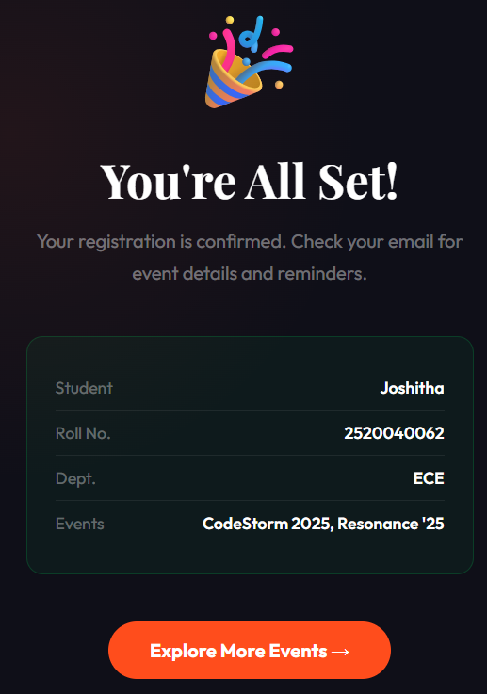

Slide 14
Conclusion
The Campus Event Navigator – Registration Hub project successfully demonstrates the use of fundamental web development technologies to create a simple and user-friendly platform for displaying campus events and enabling student registration. By using HTML for structuring content, CSS for layout and styling, and JavaScript for basic interactivity, the project presents event details in an organized manner and allows students to submit their information through an online form. This project helps improve awareness of college events and simplifies the registration process. It also serves as a practical learning experience for beginners to understand basic concepts of web page design, form creation, and user interaction in web development.

Slide 15
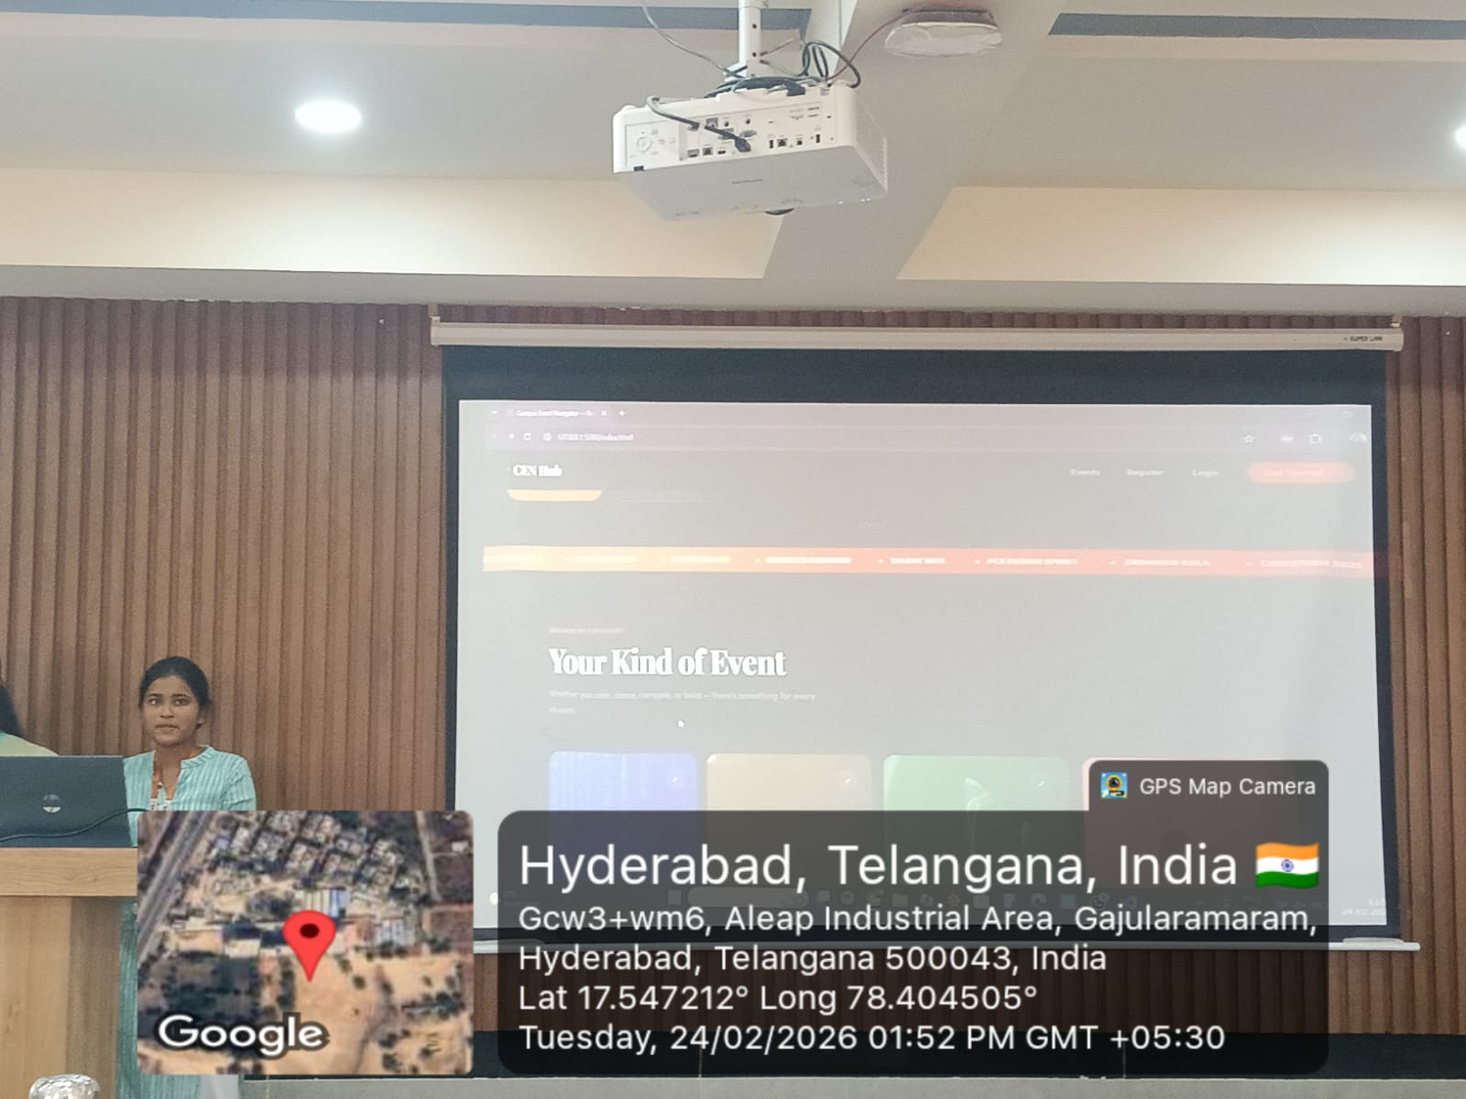
Geo- Tag Photos

Slide 16
THANK YOU

